Slide 1

Methodist College of Engineering & Technology
Mini Project On
The Analytic Hierarchy Process (AHP)

Slide 2
Our Team
AIRLA SNEHITH
Mohammed Khubaib
ASHISH KUMAR PANDIA
160720733091
160720733092
160720733093
Under the Guidance of
Mr. Shaik Kareem Basha,
Assistant Professor, Dept. of CSE

Slide 3

Unlocking the Power of AHP : Making Informed Decisions Made Easy
The Analytic Hierarchy Process (AHP) is at the core of our AHP Web App. It provides an easy-to-use and comprehensive framework for decision-makers to prioritize their options for an informed decision. In this presentation, we will take you through the fascinating world of AHP Module.

Slide 4
ABSTRACT
What is AHP?
Analytical hierarchy process is a structured technique for organizing and analyzing complex decisions,based on mathematics and psychology. It was developed by Thomas L. Saaty in the 1970s; Saaty partnered with Ernest Forman to develop Expert Choice software in 1983, and AHP has been extensively studied and refined since then.
It represents an accurate approach to quantifying the weights of decision criteria.
Individual expert’s experiences are utilized to estimate the relative magnitudes of factors through pair-wise comparisons.
Each of the respondents compares the relative importance of each pair of items using a specially designed questionnaire.

Slide 5
INTRODUCTION
AHP has particular application in group decision making, and is used around the world in a wide variety of decision making situations, in fields such as government, business, industry, healthcare and education.
Rather than prescribing a "correct" decision, the AHP helps decision makers find the decision that best suits their goal and their understanding of the problem.
It provides a comprehensive and rational framework for structuring a decision problem, for representing and quantifying its elements, for relating those elements to overall goals, and for evaluating alternative solutions.
Users of the AHP first decompose their decision problem into a hierarchy of more easily comprehended sub-problems, each of which can be analyzed independently.
The elements of the hierarchy can relate to any aspect of the decision problem, tangible or intangible, carefully measured or roughly estimated, well or poorly understood, anything at all that applies to the decision at hand.
Once the hierarchy is built, the decision makers systematically evaluate its various elements by comparing them to each other two at a time, with respect to their impact on an element above them in the hierarchy. In making the comparisons, the decision makers can use concrete data about the elements, and they can also use their judgments about the elements' relative meaning and importance.

Slide 6
Overview of AHP Module
What is AHP?
Why use AHP?
A hierarchical decision-making process that breaks down complex decisions into smaller, more manageable sub-problems.
To make informed decisions by taking into account multiple criteria, alternatives, and stakeholders' values.
How does AHP work?
What are the benefits of AHP?
By structuring the decision hierarchy, weighting criteria, and assessing pairwise comparisons between criteria and alternatives.
It provides a clear and transparent method for making decisions, improves consistency and confidence, and helps in managing complex decisions.

Slide 7
Traditional Method of Performing the Analytical Hierarchy Process (AHP)
The traditional method of performing the Analytical Hierarchy Process (AHP) involves manual calculations and decision-making without the aid of specialized software or tools.
The process typically consists of the following steps:
Pairwise Comparisons
Computing the Priorities
Conduct pairwise comparisons between criteria and alternatives to determine their relative importance. Assign numerical values to represent the relative preference of one element over another.
Normalize the comparison matrix and calculate the priority vectors for criteria and alternatives. This involves summing the values of each row or column and dividing each element by the respective sum.
1
2
3
4
5
Creating the Comparison Matrix
Sensitivity Analysis
Establishing the Hierarchy
Create a square matrix based on the pairwise comparisons. The elements of the matrix represent the relative importance values obtained from the comparisons.
Perform sensitivity analysis to assess the impact of changes in the criteria or their relative importance on the final decision.
Identify the main goal and break it down into a hierarchical structure with criteria and alternatives.

Slide 8
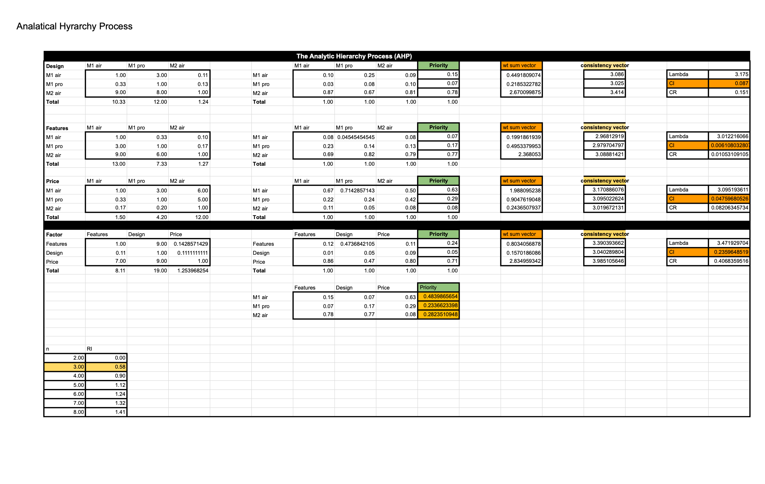

Slide 9
Drawbacks of the Traditional Method:
Calculation Complexity:
Manual calculations can become time-consuming and error-prone, especially when dealing with complex decision problems that involve numerous criteria and alternatives .
Lack of Visualization:
Without dedicated software or tools, it may be challenging to visualize and interpret the results of the AHP analysis effectively.

Slide 10
Proposed System
The proposed system aims to address the disadvantages of the traditional method by developing a web application using Python libraries such as Streamlit, NumPy, and Pandas.
The web app streamlines the AHP process and enhances user experience by providing an interactive and visual interface.

Slide 11

The workflow of the proposed system is as follows:
Pair-wise Comparison
Pairwise Comparisons
Criterion Setting:
Multicriteria Analysis
The AHP algorithm implemented in the web app asks a series of questions to generate the pairwise comparisons matrix. The user's responses are recorded and used to calculate the relative importance values.
Display Results
The user is asked to define the criteria related to the goal. This information is collected through the app interface.
The module applies mathematical algorithms, such as the eigenvector method and geometric averaging, to determine the relative importance of criteria and the rank order of alternatives.
The web app presents the option with the best priorities as the recommended choice for the given go
1
2
3
4
5
6
1
2
3
Goal Input
Option Input
Priorities Computation
The user provides the available options or alternatives for
The app uses the collected data to compute the priorities of the criteria and alternatives. This involves normalization and calculations based on the AHP methodology.
Pair-wise Comparisons
Sensitivity Analysis
The web app prompts the user to enter the goal for the AHP analysis using the st.text_input function.
The module facilitates support for pair-wise comparisons between criteria and alternatives. Pair-wise comparisons are made using linguistic variables such as "a lot better than," "slightly worse than," and "equally important."
The module performs a sensitivity analysis to test the robustness of the solution and identify potential biases and inconsistencies in the pairwise comparisons.

Slide 12
Advantages of the Proposed System:
Data Normalization
Automation and Efficiency:
The web app automates the calculations, reducing manual effort and potential errors. It streamlines the AHP process, making it faster and more efficient.
Visualization:
The use of a web app enables visual representation of the AHP results, allowing users to interpret and understand the decision-making process more easily.
User-Friendly Interface:
The interactive interface of the web app enhances user experience, making it more intuitive and accessible to a wider range of users.
Data Preprocessing
Normalization Techniques
Normalization Benefits
The module preprocesses and scales the data according to the normalization method and the decision maker's preferences, using techniques such as vector normalization, standardization, and linear programming.
The module offers various normalization techniques to address different types of data, such as quantitative, qualitative, ordinal, and interval scales.
The module enhances the comparability and consistency of the data, simplifies the calculations, and reduces the influence of extreme values and outliers.

Slide 13
Unified Modeling Language
Use Case Diagram
Class Diagram
Activity Diagram
Sequence Diagram
Component Diagram

Slide 14
Use Case Diagram

Slide 15
Class Diagram

Slide 16
Activity Diagram

Slide 17
Sequence Diagram

Slide 18
Component Diagram

Slide 19
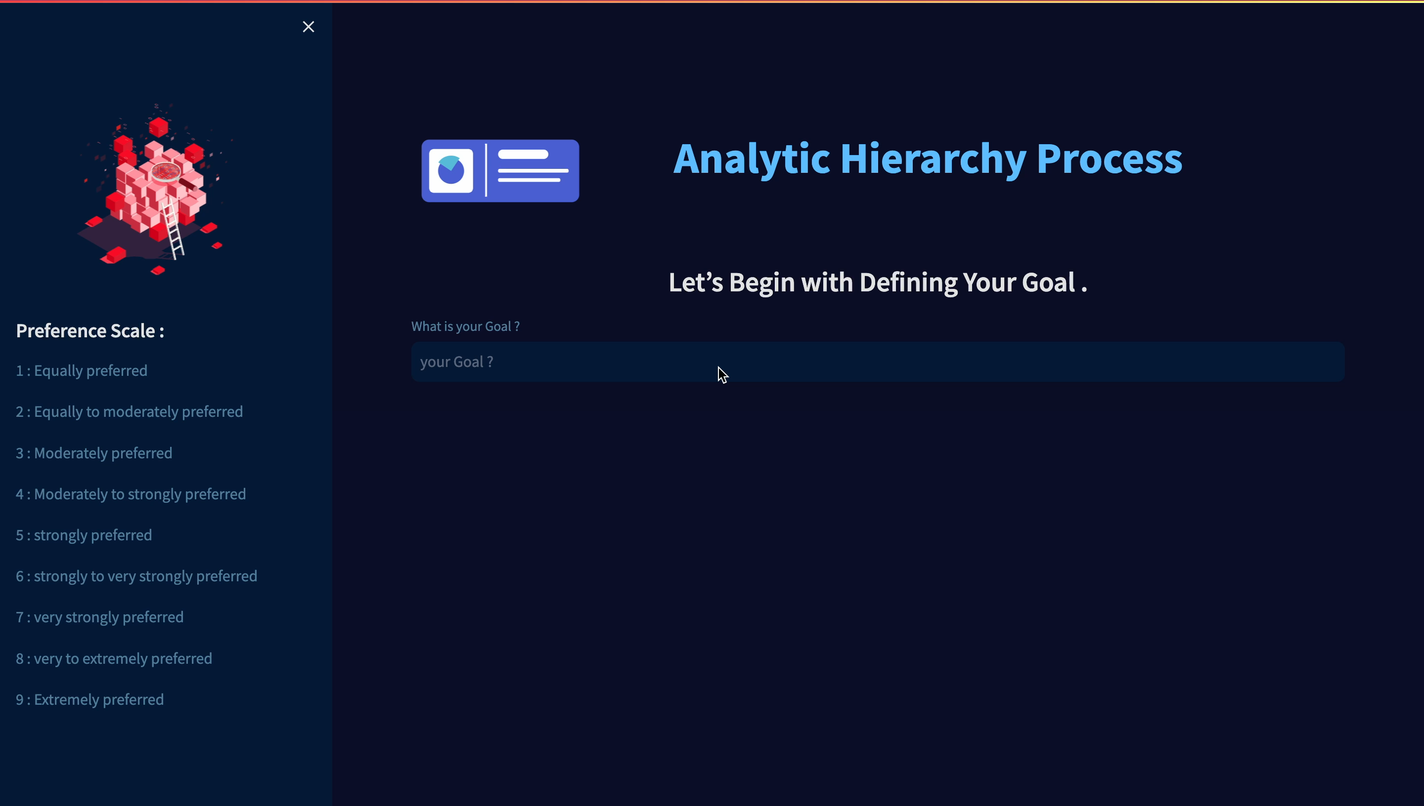

Slide 20
REFERENCES
Saaty, T. L. (1980). The Analytic Hierarchy Process: Planning, Priority Setting, Resource Allocation. New York: McGraw-Hill. This is the seminal work by Thomas L. Saaty, the creator of the Analytic Hierarchy Process. It provides a comprehensive overview of the AHP methodology and its applications.
Vaidya, O. S., & Kumar, S. (2006). Analytic Hierarchy Process: An Overview of Applications. European Journal of Operational Research, 169(1), 1-29. This paper presents an extensive review of various applications of the AHP across different domains, including business, engineering, and healthcare.
Opricovic, S., & Tzeng, G. H. (2004). Compromise Solution by MCDM Methods: A Comparative Analysis of VIKOR and TOPSIS. European Journal of Operational Research, 156(2), 445-455. This paper discusses multi-criteria decision-making methods, including VIKOR, which is related to the AHP and can be useful for further enhancing your web application's capabilities.
Tzeng, G. H., & Huang, J. J. (2011). Multiple Attribute Decision Making: Methods and Applications. Boca Raton: CRC Press. This book provides a comprehensive overview of various multiple attribute decision-making methods, including the AHP, and offers practical examples and applications.
Molina, A., & Morales, D. (2008). AHP and Goal Programming for Planning and Scheduling in a Cellular Manufacturing System. Omega, 36(6), 961-976. This paper showcases a specific application of the AHP in manufacturing planning and scheduling, illustrating how the methodology can be used in real-world scenarios.

Slide 21

Conclusion
By developing this web app, users can easily apply the AHP technique to make informed decisions based on their defined goals and criteria.
This proposed system offers a streamlined approach for decision-making, allowing users to obtain reliable results efficiently.

Slide 22
Thank You

